Slide 1
Unit 4: Create an Interactive Media Product
Learning Objective: To create and develop your navigation plans (LO2 P2)

Slide 2
So far…..
Learning Objective: To create and develop your navigation plans (LO2 P2)
Initial ideas which you speed-dated and developed.
Researched some interactive websites and apps.
Looked at the navigation and analysed an existing website.
Started to look at your own navigation

Slide 3
What have you noticed makes a successful interactive product?
What have you spotted about the navigation which made it suit the website?
What have you found works best in navigation on websites?
Learning Objective: To create and develop your navigation plans (LO2 P2)

Slide 4
Here’s some tips to write down and help you develop your ideas:
Learning Objective: To create and develop your navigation plans (LO2 P2)
E
O
S
Search engine optimisation – you want to be searchable. Be descriptive in your website to allow Google and other search engines find you. Think about descriptive language which your audience may search for to find you.

Slide 5
What keywords would you include in your website to boost your SEO for a florist website?
Example: for a chocolate shop: birthday gift collection, hand made chocolate, selection box, a gorgeous gift, tasty treats from the heart, decadent chocolate, dark chocolate, white chocolate, milk chocolate, gifts for her, gifts for him.
Challenge time: 2 minutes to list as many words/phrases as possible.
Learning Objective: To create and develop your navigation plans (LO2 P2)

Slide 6
Descriptive labels in your navigation are good for search engines The navigation bar is a key place to indicate relevance to search engines. Since your navigation appears on every page, descriptive label shows Google that you are truly about that topic.
Descriptive labels in your navigation are good for visitors Your navigation bar is visually prominent, so it communicates instantly. When it lists your main products or services, it will be obvious, at a glance, what your company does up front, so they’ll know they’re in the right place.
Use your main navigation as a place to start telling people and search engines about what you do. Use labels that use top-of-mind phrases for visitors and popular keyphrases.
Learning Objective: To create and develop your navigation plans (LO2 P2)

Slide 7
Learning Objective: To create and develop your navigation plans (LO2 P2)

Slide 8
Create your navigation plan
Stretch and challenge:
Write a blurb which would be on the front page which includes key words that would enhance your SEO. The “about us” section.
How might it look?
How could you describe each page?
What content would you include? (once you’ve placed your post it notes and are happy – analyse and label)
How can you make it more interactive?
How can you boost the SEO?
Once you’re happy with the drawn plans of your navigation map. Design your navigation bar on Photoshop (or PowerPoint if you find easier)
Learning Objective: To create and develop your navigation plans (LO2 P2)

Slide 9
Unit 4: Create an Interactive Media Product
Learning Objective:
To create a colour scheme for your interactive website.
To identify and explain what “Call to Action” is.

Slide 10
Learning Objective:
To create a colour scheme for your interactive website.
To identify and explain what “Call to Action” is.
Call to action
CALL NOW. BOOK NOW. SIGN UP NOW. LISTEN NOW. BUY NOW.

Slide 11
Grab an iPad or your phone
Learning Objective:
To create a colour scheme for your interactive website.
To identify and explain what “Call to Action” is.
Go on 2 websites – list the different colours you see.
Are the colours the same?
Are there a mix of colours?
What feel does the website have with the use of those colours?
What do you like? What don’t you like about their colour scheme?

Slide 12
CLASHING COLOURS
Learning Objective:
To create a colour scheme for your interactive website.
To identify and explain what “Call to Action” is.
Dull palettes
Colours not suitable for your product
Mixed colours can take away from the professional look and distract.
Usually the call to action is a bold or warm colour which compliments the rest of the site
To change a font colour you would need to use this HTML
<font color="#ff0000">text</font>
The #ff would depend on the colour you choose.
http://css3button.net allows you to create a button and choose the colours of button and text.

Slide 13
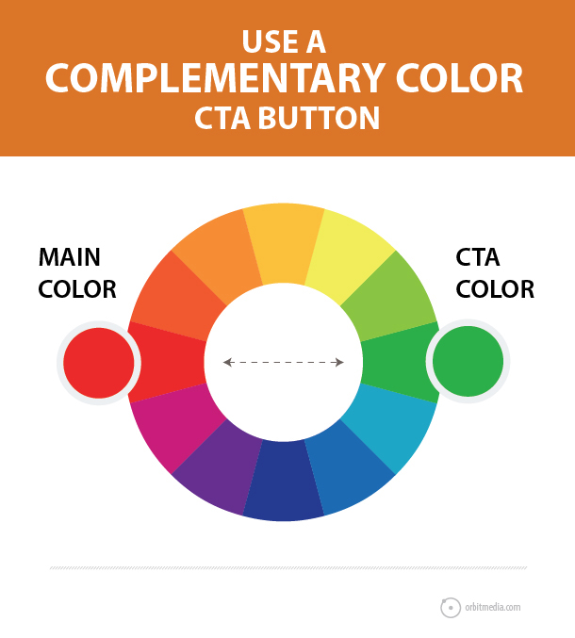
Why does colour matter?
Learning Objective:
To create a colour scheme for your interactive website.
To identify and explain what “Call to Action” is.
Colour can relate to:
Your target audience
Your product
Your business
Your professionalism
Your personality.

Slide 14
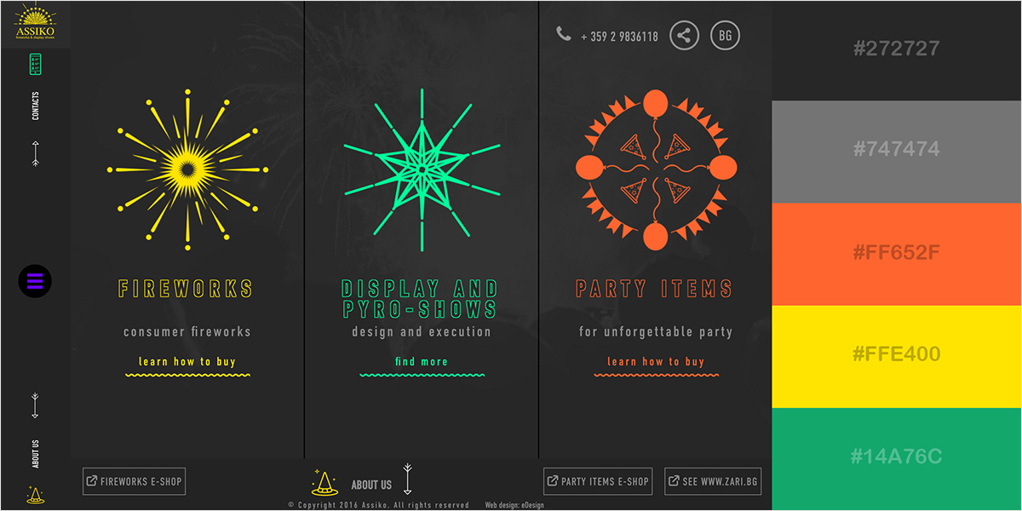
On the media website under unit 4 I’ve included a slide show of different colour schemes for your webpage. Each colour has a # to help you use this when creating html code later.
Find 6 colours that you would like to use together on your webpage by exploring the colour schemes. List them on your navigation plans and label specific features such as “call to action” or fonts that you would like in that colour.

Slide 15
What colour scheme have you chosen?
Why?
How does the colour represent your product / target audience?

Slide 16
Unit 4: Create an Interactive Media Product
Learning Objective: To create and develop your navigation plans (LO2 P2)
To self-assess and evaluate your current button ideas and hone for your portfolio

Slide 17
Action Words
Learning Objective: To create and develop your navigation plans (LO2 P2)
To self-assess and evaluate your current navigation plans and hone for your portfolio
In pairs list 10 action things you might want to do on a website.
For example: Download song.

Slide 18
Push the button….
LO: To evaluate your current button ideas and hone for your portfolio
So these buttons without verbs…
Email Signup
Whitepaper Download
More Information
…become more action oriented when the verb is added…
Sign Up for Email Updates
Download the Whitepaper
Learn More
Tip: Use an action word in every button.

Slide 19
LO: To evaluate your current button ideas and hone for your portfolio
Navigation labels such as “videos,” “photos” and “whitepapers” tell visitors the format of the content, but not the topic.
People don’t go to websites looking for videos or whitepapers. They visit websites looking for answers and information.
Labels indicating the format aren’t descriptive and therefore, not very helpful to visitors.

Slide 20
LO: To evaluate your current button ideas and hone for your portfolio
WYLTIWLT test
Would you like to……
I would like to….

Slide 21
LO: To evaluate your current button ideas and hone for your portfolio

Slide 22
Get the phone ringing
Write down notes to help you for your site:
Simple HTML to learn for today. To ensure your website connects your audience to you, you can click an “ANCHOR TAG” such as a phone number and it will allow you to call or save straight away.
<a href= “___”(what you want it to say on link) > ______(phonenumber or email address) </a>
Example:
<a href=”tel:02086861741″>(0044)2086861742</a>

Slide 23
Basic Navigation plan with hyperlinks
LO: To evaluate your current button ideas and hone for your portfolio
Use PowerPoint to design 3 flat plan versions including buttons and a navigation bar.
Vary fonts, colour schemes and descriptive words.
Evaluate what you prefer, what you think looks best and which styles are more eye-catching / user friendly.
Florist World BUY A BOUQUET VISIT THE SHOP VIEW OUR WEDDING RANGE
Download the catalogue
Watch our tutorials
Design your bouquet
Stretch and Challenge: Insert hyperlinks to either images, documents or websites you find to help you make this plan more visual.

