Slide 1
UNIT 6: sOCIAL mEDIA AND gLOBALISATION LO: 1.1 and 1.2

Slide 2
Learning Objective: Developing and strengthening knowledge of how online and social media products are used. Allowing each student to confidently explain social media products and utilise these in a marketing campaign.

Slide 3
Learning Objective: Developing and strengthening knowledge of how online and social media products are used. Allowing each student to confidently explain social media products and utilise these in a marketing campaign.
Prepare for our feedback session the answers to these questions based on your envelope:
What is your social media platform? How does it work?
What are 5 benefits to the user of this app/channel?
How do producers/content makers use this platform?
15 minutes

Slide 4
Recap on Web 2.0
Write this bit down in your own words
In 2006 Tapscott and Williams (Media theorists) talked about “Wikinomics” which suggests that online technologies have changed the way that media products are produced and distributed.
Many audience members are now known as “Prosumers”, creative individuals who utilise media technology at home to make music, television content or fan films, or they become Citizen Journalists.
Web 2.0 is so advanced it can share & distribute their content online.
Learning Objective: Developing and strengthening knowledge of how online and social media products are used. Allowing each student to confidently explain social media products and utilise these in a marketing campaign.

Slide 5
Henry Jenkins
Meaning we can all get involved. We can participate. We can create our own content online.
In 2006, Jenkins looked into Fan Films and wrote extensive papers and books about the way online technologies have enabled “participatory culture”.
Learning Objective: Developing and strengthening knowledge of how online and social media products are used. Allowing each student to confidently explain social media products and utilise these in a marketing campaign.

Slide 6
Michael Gondrey encouraged participatory culture with swedes.

Slide 7
Learning Objective: Developing and strengthening knowledge of how online and social media products are used. Allowing each student to confidently explain social media products and utilise these in a marketing campaign.

Slide 8
Creating a swede – Be kind rewind
15 minute task
You have 5 minutes to plan and 10 minutes to prep & film.
You must create a swede that is no more than 2mins30
The only materials you will be given are an ipad, paper and scissors.
Summarise your film – only rules: no editing, include a humming soundtrack and have fun!
Learning Objective: Developing and strengthening knowledge of how online and social media products are used. Allowing each student to confidently explain social media products and utilise these in a marketing campaign.
https://www.youtube.com/watch?v=4fDlPI1vI2A&t=22s

Slide 9
Learning Objective: Developing and strengthening knowledge of how online and social media products are used. Allowing each student to confidently explain social media products and utilise these in a marketing campaign.

Slide 10
Word of mouth - online
Learning Objective: Developing and strengthening knowledge of how online and social media products are used. Allowing each student to confidently explain social media products and utilise these in a marketing campaign.

Slide 11
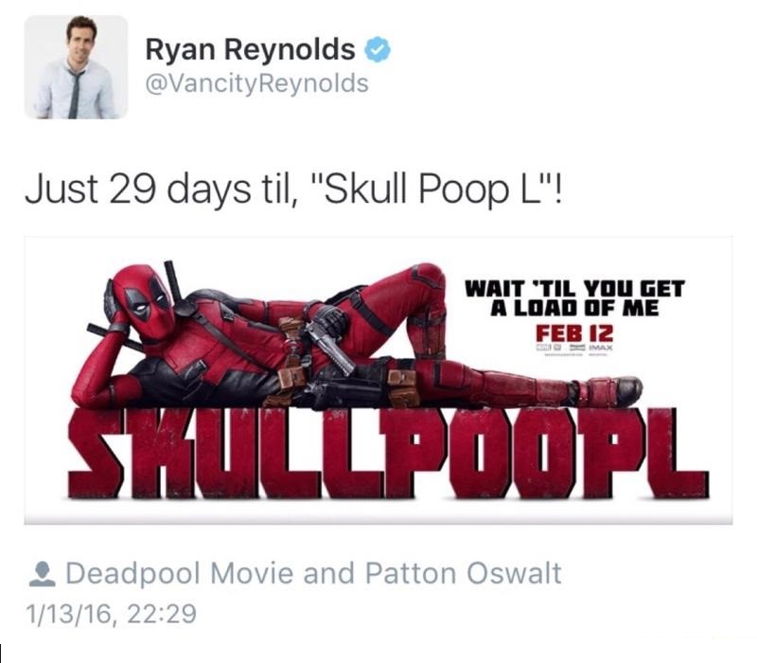
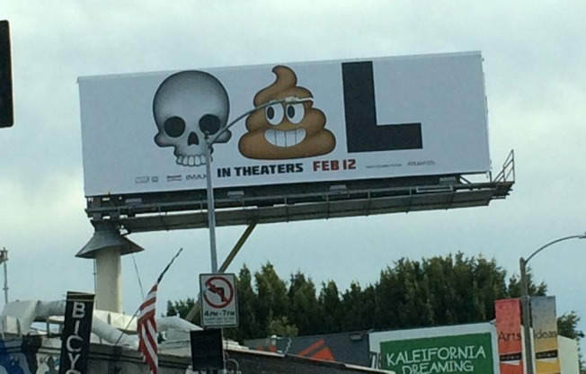

Slide 12
Twitter played a massive part in the Deadpool campaign
Using Ryan Reynold’s STAR POWER and asking the audience to produce photos of any images they see in relation to Deadpool
Youtube played the strongest part in the Be Kind Rewind with the introduction of audience made swedes.
Both are a modern day word of mouth. Both campaigns ask the audience to take part.
Learning Objective: Developing and strengthening knowledge of how online and social media products are used. Allowing each student to confidently explain social media products and utilise these in a marketing campaign.

Slide 13
In your envelope groups:
5 minutes to discuss in groups
Choose a current TV show or Hollywood film.
Decide how you could promote your film/TV show.
Encouraging an audience participation element.
What might encourage more people to hear about your product?
Learning Objective: Developing and strengthening knowledge of how online and social media products are used. Allowing each student to confidently explain social media products and utilise these in a marketing campaign.

