Slide 1
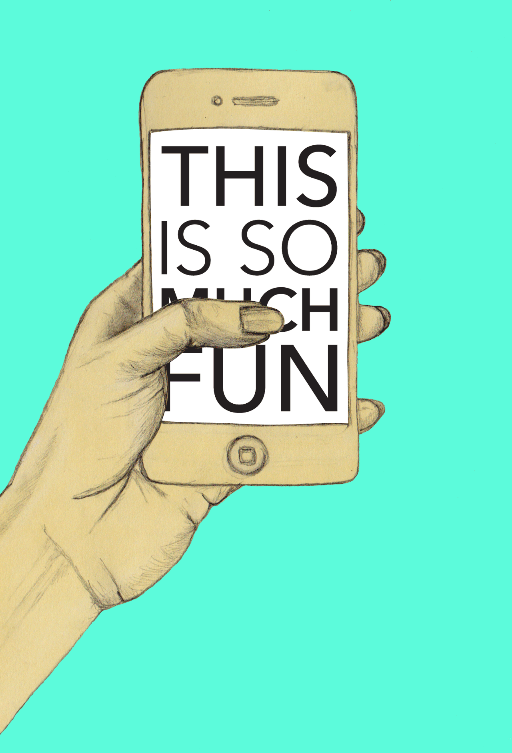
Unit 6: Social Media and Globalisation
Lo2: explain the impact of social media and globalisation on media audiences and producers

Slide 2
Starter
Lo2: explain the impact of social media and globalisation on media audiences and producers
In pairs choose a local business of your choice
Pick 3 social media channels
Create a mind map, outlining the benefits that using social media might have on the business

Slide 3
Lo2: explain the impact of social media and globalisation on media audiences and producers
Negative impacts for users and industry:

Slide 4
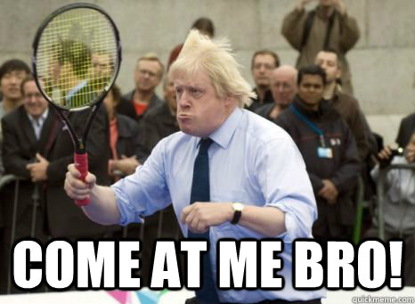
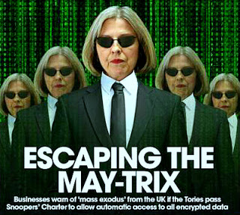
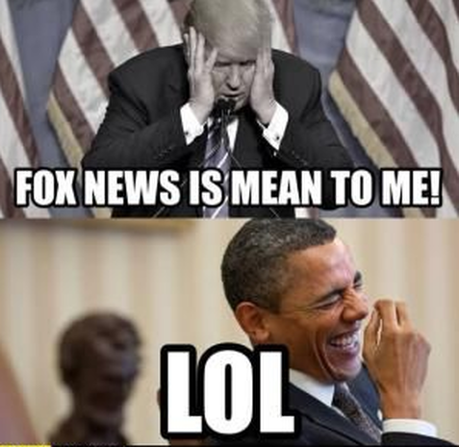
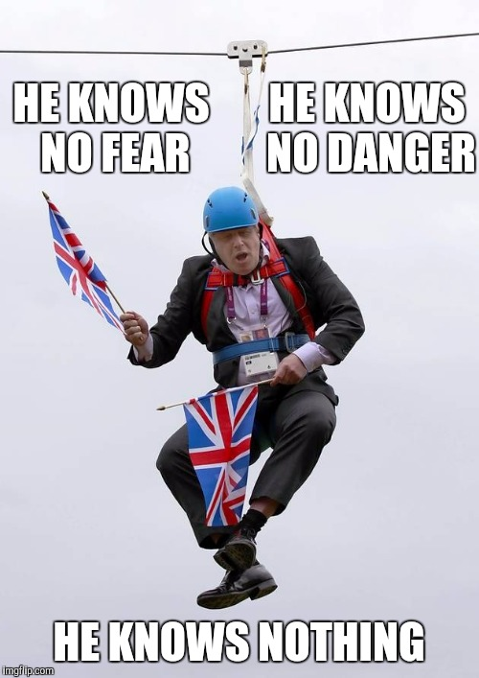
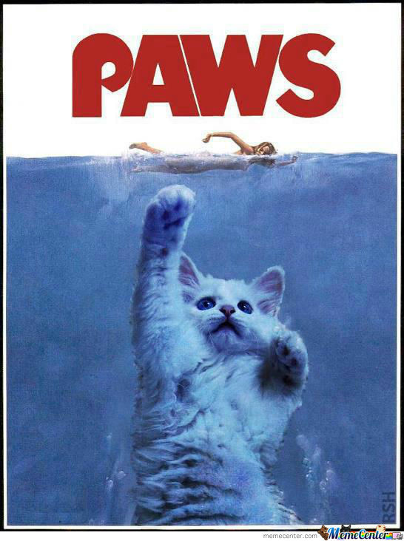
Memes – brand and celebrity parody
Lo2: explain the impact of social media and globalisation on media audiences and producers

Slide 5
TASK
Group A: Vicky Pattison, Taylor Swift, Harry Styles
Group B: Kylie Jenner, Maya Jama, Jemma Lucy
Group C: Holly Hagan, Kem Cetinay, Aaron Chalmers,
Group D: Kim Kardashian, Casey Batchelor, Lethal Bizzle
Analyse the content of the last 3 images they have posted on instagram.
Is the content appropriate for young people?
Is there any sponsorship shown? How is this portrayed?
What are your overall thoughts on this user’s account? Is it useful social media content?
Lo2: explain the impact of social media and globalisation on media audiences and producers

Slide 6
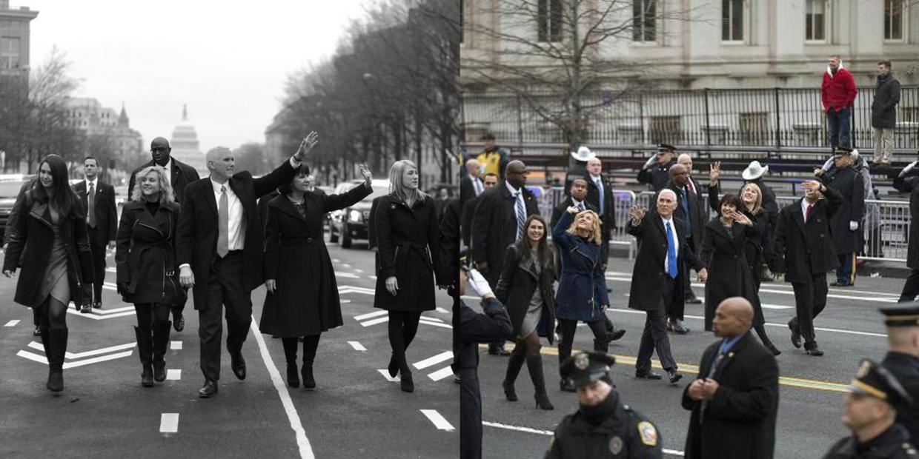
FAKE NEWS Task
Lo2: explain the impact of social media and globalisation on media audiences and producers
Trump blames the mainstream press and social media for “Fake news”. With the instant nature of social media commenting on every day news events – do you think it’s a good or bad platform? Research a celebrity story and present back your research arguing your view point on Social media and globalisation.

Slide 7
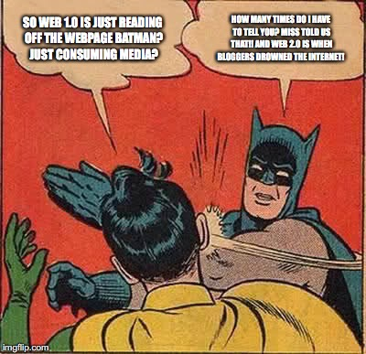
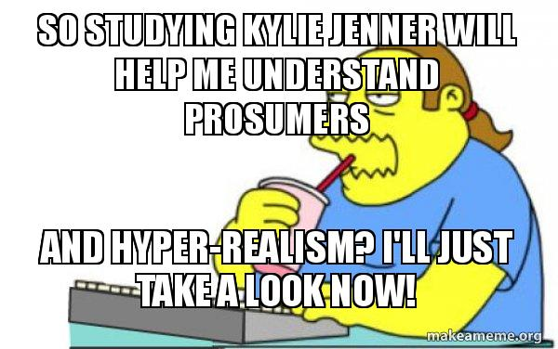
Plenary
Create a meme using the ipads or your smart phone which represents your learning on this unit so far.

