Slide 1
Unit 6 Social Media and Globalisation
Learning Objective: To explain and compare the key features of a social media campaign.

Slide 2
For a good social media campaign you need:
Ideas generated and collaborative projects: Wikinomics, Grassroot projects……..Virtual team working tools such as “ChatGrape”, “OPEN Forum”, ”Slack”, “Sqwiggle” allow you to float ideas to attract like-minded people and create your own team.
Funding – Kickstarter is a great online campaign helper for media projects.
Evaluating/review tools: social media measurement and aggregation. Free analysis tools : Hootsuite, Back Tweets and Mention allow you to collate trending data/hashtags. ………….Postano and Flavors allows you to stream your feeds live to any types of devices (live data on the move – aggregation).
Blended marketing and synergy – keep your brand on point.

Slide 3
Social Media Sales Funnel
A social media campaign is just like any other media production with regards to planning.
What do you need to do to plan it?
Generate Leads
Build Credibility
Vital part of understanding the stages that a social media campaign will take so that deadlines, milestones and content release can be successfully planned.
Stay top of mind
Drive to sweet spot
Strengthen
relationship
Earn Referrals
Learning Objective: To explain and compare the key features of a social media campaign.

Slide 4
Learning Objective: To explain and compare the key features of a social media campaign.

Slide 5
Learning Objective: To explain and compare the key features of a social media campaign.
Established
Reinforced

Slide 6
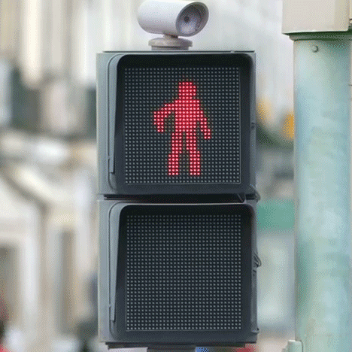
QUIZ TIME
STOP

Slide 7
Question 1
Learning Objective: To explain and compare the key features of a social media campaign.
Bird lover magazine is a magazine especially tailored to a
A.
Nice Audience
B.
Neice Audience
C.
Niche Audience
D. Demographic Audience
E. Diplographic Audience
F. Deadographic Audience

Slide 8
Frequent
Timed
Learning Objective: To explain and compare the key features of a social media campaign.

Slide 9
Game preview
Free download
Exclusive album track
Behind the scenes videos
Free stuff
Learning Objective: To explain and compare the key features of a social media campaign.

Slide 10
QUIZ TIME
STOP

Slide 11
Question 2
Learning Objective: To explain and compare the key features of a social media campaign.
Folksonomy is the system which
Users of online & social media technologies use to tag to position their content.
Users of social media use it to collaborate with folk singers
Users of social media use it to grow their audience of folk lovers.

Slide 12
Question 3
Learning Objective: To explain and compare the key features of a social media campaign.
USP is……
1. Universal Sales Pitch
2. Unique Selling Point
3. Unique Sales Patch

Slide 13
Staying connected and strong
Reinforcing connections – sharing links to all mediums
Learning Objective: To explain and compare the key features of a social media campaign.

Slide 14
Question 4
Learning Objective: To explain and compare the key features of a social media campaign.
People who have grown up with the Web, Web 2.0 and digital hardware are…..
Digitally Dynamic
Digital Immigrants
Digital Natives

Slide 15
Learning Objective: To explain and compare the key features of a social media campaign.

Slide 16
QUIZ TIME
STOP

Slide 17
Question 5
Learning Objective: To explain and compare the key features of a social media campaign.
Content can’t be accessed in every country. Due to censorship some countries ban content in searches. In some cases, they have created their own social media networks. In certain countries the government has tight control on both tradition and new media to avoid potential subversion of authority. What country currently blocks Facebook, Twitter, Instagram, Google (including Google+), Gmail and Youtube?
China
Dubai
Russia

Slide 18
Question 6
Learning Objective: To explain and compare the key features of a social media campaign.
Algorithmia is where a daily report is created on user interaction with marketing material. This is one way that media producers can measure the impact of campaigns, events and marketing material in general. This type of automated analysis is crucial for good social media marketing and is called:
Separate Analysis
Siesta Analysis
Sentiment Analysis

Slide 19
WELL DONE – you’re social media savvy!!
Learning Objective: To explain and compare the key features of a social media campaign.
So let’s keep going!

Slide 20
Learning Objective: To explain and compare the key features of a social media campaign.
When there is no payment to boost advertising, followers or tweets.
Content # and SEO keywords have got you these results

Slide 21
Practical Task
Learning Objective: To explain and compare the key features of a social media campaign.
1. Choose a new film or new album that has just launched.
Example : Taylor Swift’s New song and brand relaunch
2. Check out the websites and social media connected to this
Example: Her Instagram, website and twitter.
STRETCH AND CHALLENGE: (Use www.archive.org to see it’s development since the website was first created).
In pairs research the following
3. What key features of the social media campaign for this product are you spotting? How are they doing this?
Example: Taylor uses her twitter to “Drive to sweet spot” by enticing them with early previews of her new music video.
4. How successful is this campaign? What are you noticing about audience engagement?
Example: There are lots of tweet replies, retweets and likes and her YouTube has received XXXXXX views.
Next Challenge:
Analyse the language and graphic content from the company feeds. Compare them with the actor/artist’s pages. Note down any differences/similarities.

Slide 22
What did you spot?

Slide 23
WRONG ANSWER
Try again

