Slide 1
How meaning is created in media products
L.O. – How do media products use production techniques to create meaning?

Slide 2
You must understand this…
The creators of media products encode messages and meanings within the product through media language
Audiences decode these messages and respond to them in different ways
encode – communicate ideas and messages through a system of signs
decode – the process through which an audience interprets a message

Slide 3
Codes and conventions
These are used by media producers when creating media texts
You should be able to identify the conventions of a media text and explain why they are used (intended effect on the target audience) due to the codes chosen
codes: familiar and predictable techniques used by producers to communicate certain ideas or a desired impression. Technical codes: created through technical equipment (camera used to give us a character’s point of view) see framing sheet. Symbolic codes: something that gives meaning that is not apparent (villains may wear dark colours as it represents evil in Western culture)
conventions: commonly accepted way of doing things – the ‘rules’ that are followed

Slide 4
Conventions
Codes

Slide 5
Conventions
Codes

Slide 6
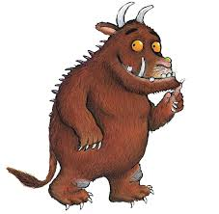
Macro and Micro concepts
Macro concepts:
Language, institution,
audience, representation, genre, narrative
Micro concepts: mise-en-scene,
camera, editing and sound.

Slide 7
Denotation and connotation
Symbols and signs all have hidden meanings
Denotation: red hospital cross
Connotation: help, medical care, doctors, nurses etc.

Slide 8
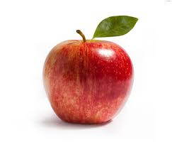

Slide 9
Definitions (write these down)
denotation- what an image actually shows and what is immediately apparent, rather than the assumptions an individual reader might make about it
connotation – the meaning of a sign that is arrived at through the cultural experiences a reader brings to it

Slide 10
The ‘Harry Potter and the Deathly Hallows’ film poster denotes a male character wearing dirty clothes and blood on his face. This connotes that this film will be darker in tone than the previous Potter films, because it features violent scenes. The denotations of the poster include a male character at the front of the poster connoting that he is the main character.

Slide 11
Genre, Representation and Stereotypes
The genre is the theme or style of the media. What genres can be included in the three media forms?
Radio
Film
Print

Slide 12
Representation
The way in which people, places or events are re-presented to audiences
Designed to be believable, however if you look closely they are often stereotypical
Event
Mediation/
construction
What we see!
Things will be added, altered or omitted

Slide 13
The effect of airbrushing
mediation

Slide 14
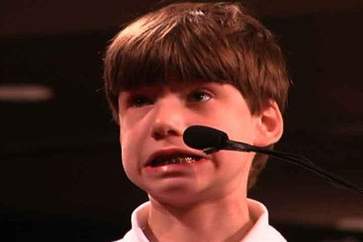
A single image could be considered open, as the meaning is uncertain. A caption or written messages will limit the meaning of an image, making it become more clear or closed.This caption can help to anchor the meaning of an image. This is known as anchorage, the fixing or limiting of a particular set of meanings to an image, usually seen underneath a photograph.
If an image has many interpretations it is known to be polysemic. Anchorage can be used to limit the number of interpretations for an audience.
How could a caption anchor this image? How could anchorage be used to manipulate an audience?

Slide 15
Dentist permanently freezes boy’s mouth.

Slide 16
Britain’s dentists are heading towards the perfect smile!

Slide 17
Michelle gets left out again!
What did he do?
Michelle and Barack on the Rocks?
The effect of anchorage

Slide 18
Why is she so covered up?

Slide 19
Write 3 anchorage lines which would alter the way the public see this picture?

Slide 21
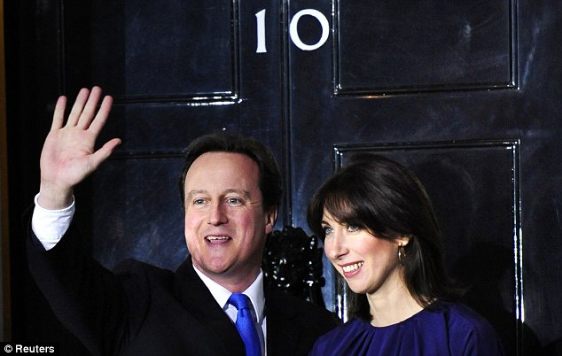
What anchorage text might appear with the following image in both The Sun and The Mirror?

Slide 22
Fill in the blanks
Media texts are __________, which means ___________________________________.
When a media text has many different interpretations it is considered ________, so ___________ is used to _______ the various meanings, helping us to analyse it in the way the producer intended us to.

Slide 23
Representation is how media texts deal with and present to an audience. Representation can include:
gender
age
ethnicity
national and regional identity
social issues
events
Media texts have the power to shape an audience’s knowledge and understanding about these important topics.
This makes them very powerful in terms of influencing ideas and attitudes.

Slide 24
Terminology
Other words connected with representation include:
Stereotypes (the view of how the thing should be/is)
Challenging (whether it is as should be or different)
Anchorage (words written to accompany the pictures which influence our opinion)
Ideology (the perfect example of…)
Camera angles
Editing
Audio codes (dialogue)
Visual codes (symbols which has layers of meaning)
Iconography (something we always associate with something else)
Mode of address
Layout (in print)

Slide 25
You are going to look at the micro elements of how media texts have been constructed
Mise-en-scene (everything you can see in the frame: setting, lighting, costume, body language, props etc.)
Camera work (shot types, angles, movement)
Sound (diegetic and non-diegetic)
Editing (transitions used, continuity)
But how do these things create meaning for an audience?
Find 3 consecutive screen shots from the trailer and analyse it using MCSE.

Slide 26
JOKER CLIP
In 4 groups - Investigate your micro element in the clip.
Analyse it and feedback how it has been used to create meaning in this clip.
Mise-en-Scene | Camera Work
Sound | Editing

Slide 27
The construction of an audio visual media product
What are the codes and conventions of a film trailer?

Slide 28
Diegetic sound
Non-diegetic sound
Title graphics
Close up shots
trailers
Non linear narrative structure
transitions
Create spectacle and enigma

Slide 29
Watch the following trailer
Justice League
What codes and conventions are used in this one?

Slide 30
MISE EN SCENE
CAMERA WORK
EDITING
SOUND

Slide 31
Exam Style Question
How has meaning been created in one media product you have studied?

Slide 32
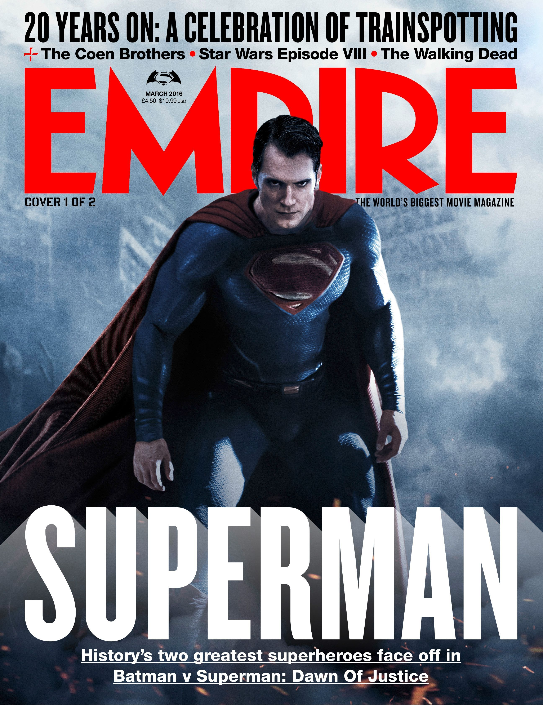
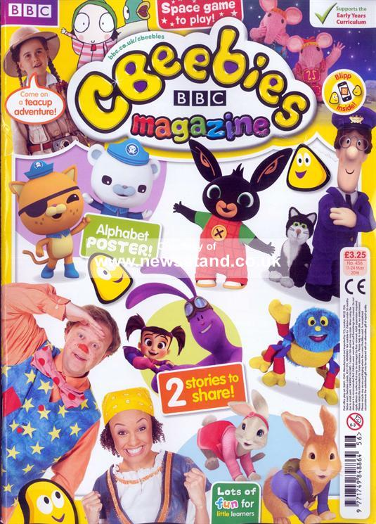
In print and websites

Slide 33
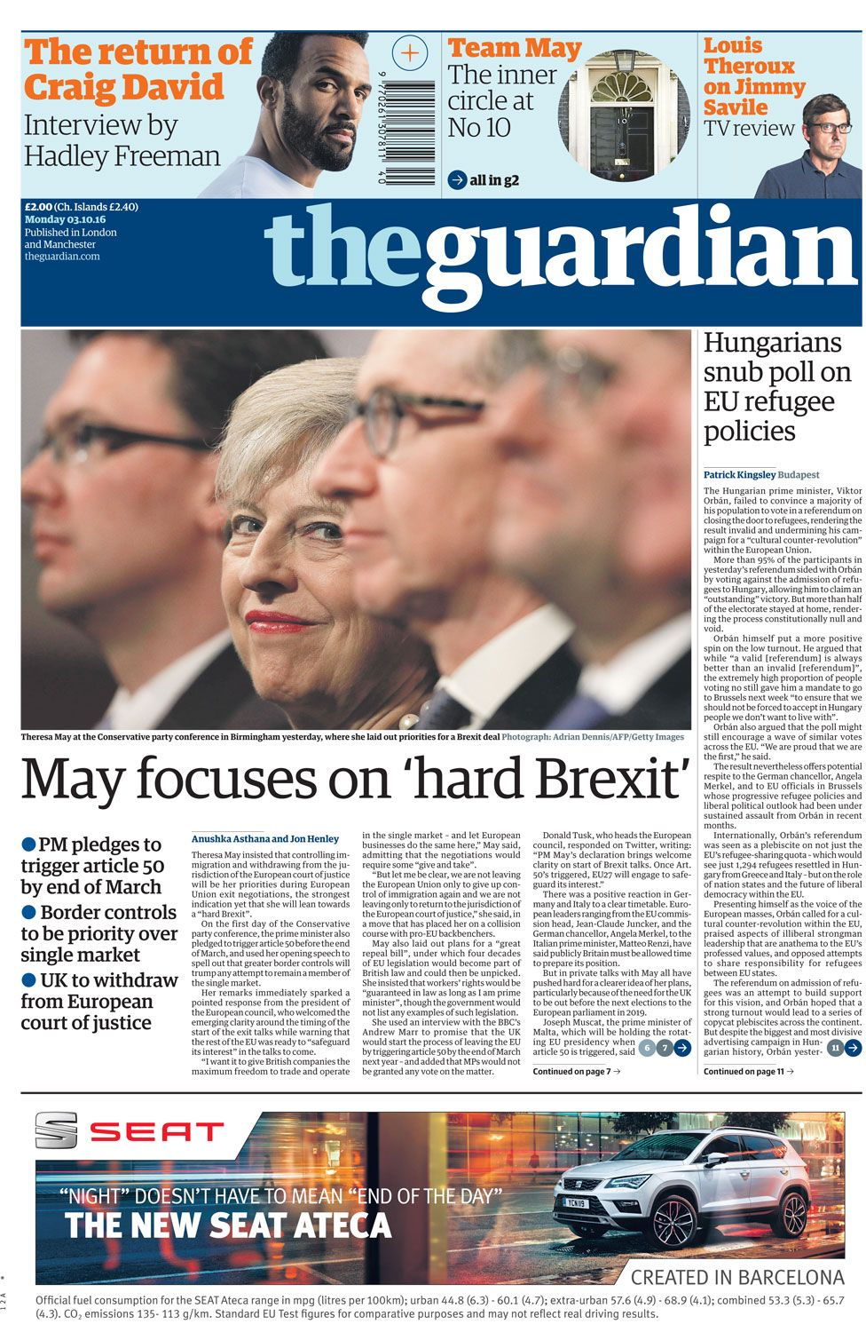
Newspapers

Slide 34
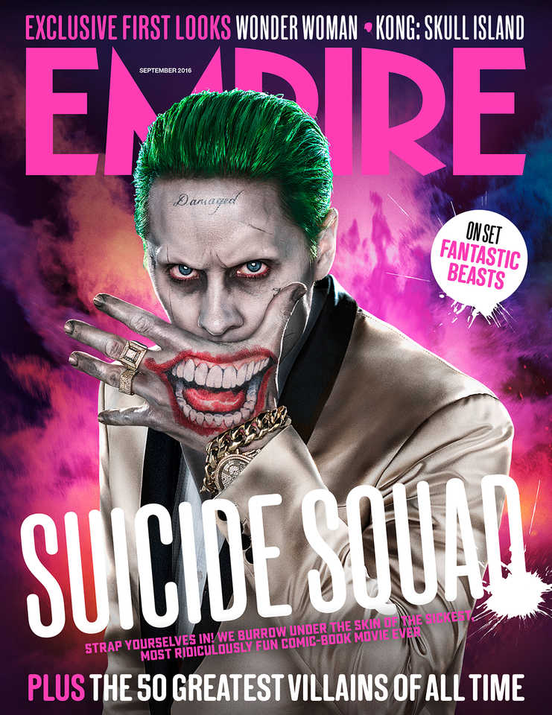
Key terminology
Font (serif/sans serif)
barcode
cover line
masthead
plug
Banner/flash banner
Main cover image/graphic
Mode of address (peer to peer, parent to child, tutor to pupil etc)
Main cover line
Anchorage (images pinned down by text)
House style

Slide 35
Homework
Find a radio advert and analyse how the codes and conventions help the audience to create meaning.
You should use the following key words:
Dialogue, mode of address, sound effects, music, jingles, sound motifs, representation, connotation, institution, language and audience!

Slide 36
Critical and theoretical analysis of media texts
L.O. – How can we apply theory to media products?

Slide 37
Why is this important?
Now we have identified the micro elements technical and symbolic codes within media texts we have to understand why they’ve been used
we have to look at theories relating to representation, narrative and genre to examine the wider messages media products offer to society

Slide 38
Theories of representation – Laura Mulvey (1975) Objectification of women in the media
Mulvey suggested that women were presented as sex objects in all media texts (she focused on film in particular)
she said that the media industry was run by men, so we were given their view on the world re-presented to us
the camera acts as the male viewpoint (known as the male gaze), so the images shown provide an erotic pleasure for heterosexual men
Mulvey said that females accept the male gaze as it is constantly reinforced across media texts
Look at the following clip https://www.youtube.com/watch?v=yl2Eh8swrEs. Why should society be concerned with the way that women are represented in the media?

Slide 39
Are things changing?
https://www.youtube.com/watch?v=FdHJG67xmsQ

Slide 40
Narrative theories

Slide 41
Todorov (1969) – 5-step narrative formula
Equilibrium – the setting is established, key character(s) are introduced and the storyline is set up
Disruption – oppositional character(s) (characters who will play opposite the central character, either in a relationship, e.g. the hero/heroine, or in conflict, e.g. the hero/villain) appear and the story takes a particular direction

Slide 42
Recognition of disruption – the lives of the characters and events are interwoven. Tension builds throughout this section, which is often the longest
Attempt to repair disruption – the highest point of tension after which there is a change in dynamic
Reinstatement of equilibrium – matters are sorted out, problems are solved and questions answered
Think of a fairy story you were told as a child. How well does the story follow Todorov’s 5 stages?

Slide 43
Subversion of the narrative
Modern narratives may subvert our expectations using:
Flashback – where a section of the film is referred back to
Flashforward – where a section of the film from the future is shown before it would normally have happened
Twist – where part of the film (often the end) is unpredictable or even shocking
Parallel narratives – where the lives of characters move alongside each other for some of the film without them meeting
Can you think of any TV programmes or films that use a subversion of the narrative? Why might audiences like narrative subversions

Slide 44
Levi-Strauss (1958) – Binary Opposition
Within a story conflict is needed to create interest in the audience
One way to create conflict is to use two oppositional forces
e.g.
light/dark
good/evil
noise/silence
youth/age
These opposites are embedded in narrative and mise-en-scene

Slide 45
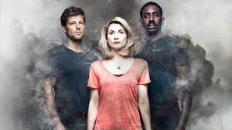
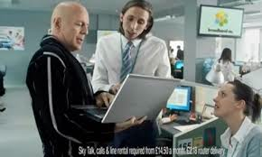
What Binary Opposites can you see in the images below?

Slide 46
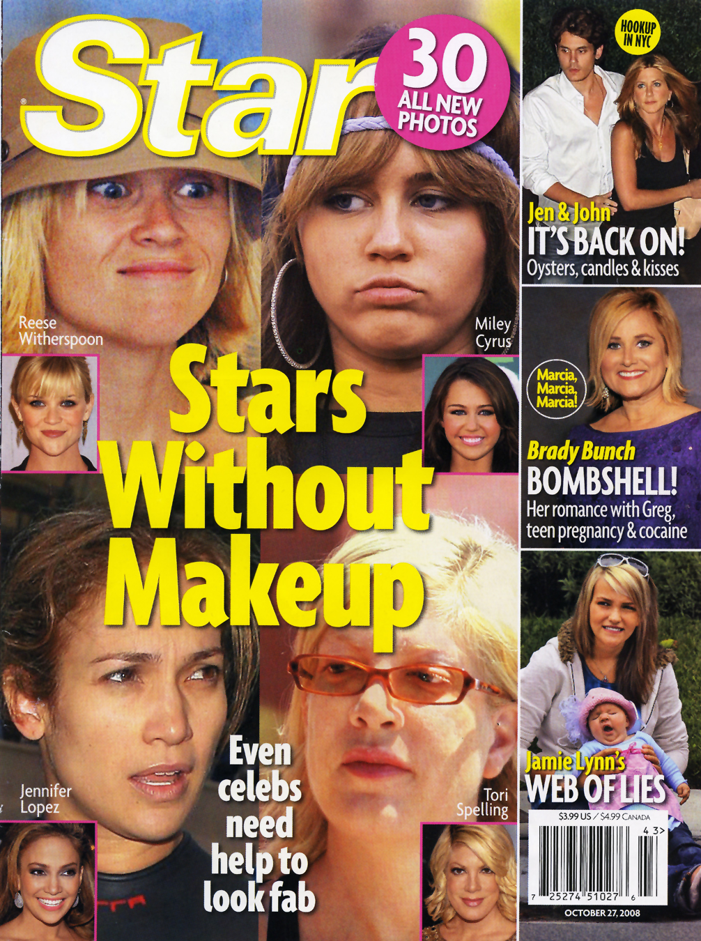
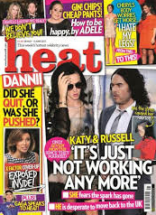
Can apply to print media as well, what binary opposites can you see in the magazines below?

Slide 47
Genre theories: Altman (1999) – Audience pleasures
Altman argues that genres offer audiences ‘a set of pleasures’, such as:
emotional pleasures – does the text make the audience happy, sad, nostalgic etc.?
visceral pleasures – ‘gut’ responses, such as excitement, fear, laughter
intellectual puzzles – does the text make the audience think?

Slide 48
this theory suggests that we get a sense of familiarity with many texts, due to the specific set of codes and conventions
texts also make us interact with the product
What type of media texts offer emotional, visceral and intellectual audience pleasures?

