Slide 1
Unit 1: Different types of media ownership
L.O. – Who owns the different types of media organisations?

Slide 2
This will focus on LO1 of your examination:
Understand the ownership models of media institutions
specialist providers – media companies that produce and distribute products within a specific media
Media Sector | Specialist providers
Film | Warner Bros., Lionsgate, Netflix
Television and radio | BBC, Netflix, ITV
Video games | Ubisoft
Print and publishing | Hachette Publishing
Web and online technologies | Facebook, Instagram
Music | Universal Music Publishing Group

Slide 3
The different types of media companies

Slide 4
conglomerate: a large organisation that is made up of a number of different businesses
many well-known global companies are part of a larger media conglomerate
e.g. Sky is a large digital, multinational broadcaster, but is a subsidiary of the broadcasting conglomerate 21st Century Fox, which is founded by media mogul Rupert Murdoch
subsidiary – a company controlled by a conglomerate

Slide 5
Top largest media conglomerates in 2016
conglomerate | subsidiary
The Walt Disney Company | ABC TV, HULU streaming, Marvel, Lucasfilm
Comcast | NBCUniversal cable networks, Universal Studios
21st Century Fox | Sky, Fox
Bertelsmann | RTL (TV and radio group), Random House and Penguin publishing house
Viacom | MTV, Nickelodeon, Comedy Central, Channel 5 (UK), Paramount
CBS Corporation | CBS TV Network, CW Network, Simon and Schuster

Slide 7
Do conglomerates own all of the media organisations?
the more familiar organisations are often conglomerates
there are many independent companies that operate differently
they may work on productions with smaller budgets
they can work with other companies on joint venture projects
independent companies may have greater creative control over what they produce – why is this?
independent companies may need support from larger organisation if they want distribution to a mass audience
Vickery and Hawkins (2008) suggest that independent companies will license their films to distribution companies who will release them on their behalf

Slide 8
Definitions
independent companies – companies free from the control of a conglomerate. They often specialise in producing one type of media product or service
joint venture – when a media company works with another company on a project that is mutually beneficial for both
distribution – this includes two parts: firstly, how a product reaches an audience and secondly, its marketing and promotion

Slide 9
Public service ownership
the BBC is the UK’s biggest public service broadcaster
the BBC’s first Director General, Lord Reith, set out the aim of the BBC, which was to inform, educate and entertain
this aim is still the same today
the BBC is still a conglomerate and is one of the biggest cross-media organisations in Europe
other UK, public service broadcasters include Channel 4 (funded through advertising), Channel 3 (owned by ITV plc) and Channel 5 (owned by Viacom). Channel 3 and Channel 5 are fully commercial and funded by advertising
cross-media – a conglomerate that produces more than one type of media

Slide 10
Task:
Look at the article and answer the following questions http://www.bbc.co.uk/corporate2/insidethebbc/whoweare/ataglance:
What is the purpose of a public service broadcaster?
What is the mission statement of the BBC?
How is the BBC funded?
How does the BBC have cross media ownership?

Slide 11
Answers:
What is the purpose of a public service broadcaster? To create content for the public rather than for commercial purposes.
What is the mission statement of the BBC? To enrich people’s lives with programmes that inform, educate and entertain.
How is the BBC funded? The licence fee.
How does the BBC have cross media ownership? TV, radio, magazine.

Slide 12
How media companies operate: vertical and horizontal integration
vertical integration is where a company can control the production, distribution and consumption of its products
it is sometimes known as a value chain

Slide 13
how can a conglomerate use this integration, compared to an independent company?
Conglomerates can use vertical integration to control the production, distribution and sometimes exchange of a product using their subsidiaries. This therefore makes it possible for a conglomerate to utilise this integration. However, because independent companies do not have subsidiaries, they have to rely on joint ventures to distribute and exchange their products and therefore cannot use vertical integration.

Slide 14
horizontal integration is where a company uses its subsidiaries to help to market a media product across different platforms/ subsidiaries

Slide 15
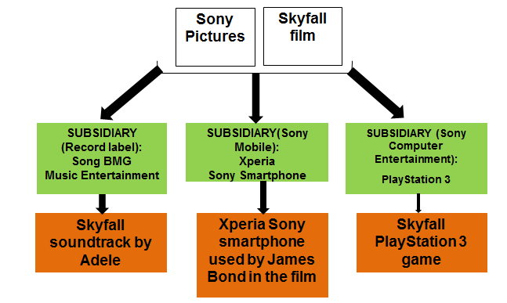
horizontal integration
what are the opportunities for a company based on horizontal integration?
It can easily cross promote brands and products across different subsidiaries/platforms to generate a larger profit. It also means that it is easier to reach a mass audience.

Slide 16
Production
Online and social media services
Print media and print advertising
Distribution
TV channels
Merchandising
Horizontal integration
Vertical integration
Consumption

Slide 17
Synergy and cross media promotion
the effect of horizontal (and vertical) integration is called synergy which means cross promotion
examples of synergy include: ITV and The X factor (TV show, app, Twitter, Facebook), The Martian film (TV, radio, magazines, online), Halo 5: Guardians (Xbox, Microsoft Lumia, Microsoft tablet computer).
What other examples of synergy can you think of?
synergy – the increased efficiency and profit that occurs as a result of vertical and horizontal promotion

Slide 18
Job roles in the media
The production process is when a media product is being made and includes pre-production, production and post-production:
pre-production includes all the planning and drafting stages of a media product (scheduling, funding, casting, designing, location scouting, storyboarding, scriptwriting)
production includes all the actual making of a media product (filming, photographing, writing, inking graphics, recording sound)
post-production includes the ways the media product is edited (CGI and special effects, digital manipulation, editing)

Slide 19
there are many roles that contribute to the final creation of a media production
you have chosen the course as you want to work in the media industry
it is important to think about the type of role you would like to work in
Task:
Choose a media industry you would like to work in.
Find three to five job roles for the sector you have chosen and explain which part of the production processes they might be involved in.

Slide 20
Using the infographic, in pairs, answer the following:
What is a cross media company?
What subsidiaries does 21st Century Fox own?
How can this type of ownership impact a conglomerate compared to an independent company?

Slide 21
Answers:
What is a cross media company? A company that can produce more than one type of media product.
What subsidiaries does 21st Century Fox own? Fox, Fox News, FX, National Geographic channels, 20th Century Fox, BSkyB.
How can this type of ownership impact a conglomerate compared to an independent company? For a conglomerate it means that it can generate a large revenue from the products the subsidiaries make as part of the conglomerate. The subsidiaries can each create synergy by promoting/marketing each others’ products which will be easy and cheap to do. It also means it is easier to target a mass audience. However an independent company, although it may be able to make two different types of products (e.g. Warp Films and Warp Records), may still need joint ventures to distribute and exchange products to an audience. However web 2.0 is making it easier for independent companies to reach an audience.

Slide 22
Research Task: Conglomerates v independent companies
Individually, you will now research one conglomerate and one independent company based on the media sector provided (film, TV and radio, print and publishing, web and online, music) . You will use the focus areas below to evidence your research:
Name of chosen independent company:
Name of chosen conglomerate company:
You must find out about the following for each company:
Evidence that it is an independent company OR evidence that it is a conglomerate company (i.e. what are its subsidiaries? cross media ownership examples?)
Example of synergy
Examples of joint ventures
Based on your findings state what the similarities and differences are between your chosen/assigned companies

