Slide 1
Unit 1: Media Ownership – A recap
L.O. – How can we show our understanding of what we have learnt about media ownership?

Slide 2
You need to be able to use the following words accurately and give examples of each
Industries
Conglomerate
Independent
Public service model
Synergy
Horizontal integration
Vertical integration
Cross media ownership
Technological convergence

Slide 3
A quick recap then...
Industries – refers to all media bases. (film, radio, print, music etc)
Operating models – how companies work to achieve their outcomes
Production processes – pre-production (planning stages), production (making it), distribution (marketing and advertising) and exchange (audience interaction)
Conglomerate – a massive profit based company that owns many subsidiaries
Independent – a single entity working for itself
Public service model – non profit, can own subsidiaries but generally used for information, education and entertainment.

Slide 4
Here are some more for you…
Cross media ownership – production by a conglomerate of more than one type of media
Technological convergence – how technology is now multifunctional and inter connective.
Synergy – when companies promote their product through other products which maximised and magnifies exposure to the product (very similar to joint ventures, but more linked to companies within the same company/conglomerate)
Vertical integration (the result) – when a company uses its subsidiaries to create, distribute and advertise its own products
Horizontal integration (the process) – this allows conglomerates to use their subsidiary companies to promote across media platforms. In an independent company this would be a joint venture

Slide 6
This is the result…

Slide 7
An example of synergy in the media
meanwhile

Slide 8
SYNERGY
JOINT VENTURE
When two or more products are released by the same company simultaneously to promote each other
When an independent company needs help in the distribution or exchange part of the process
VERTICAL INTEGRATION
The result of a company being able to produce, distribute and exchange due to subsidiaries or joint ventures
HORIZONTAL INTEGRATION
This allows conglomerate companies to cross promote a product using their subsidiary companies. In independent companies, they would need a joint venture.

Slide 9
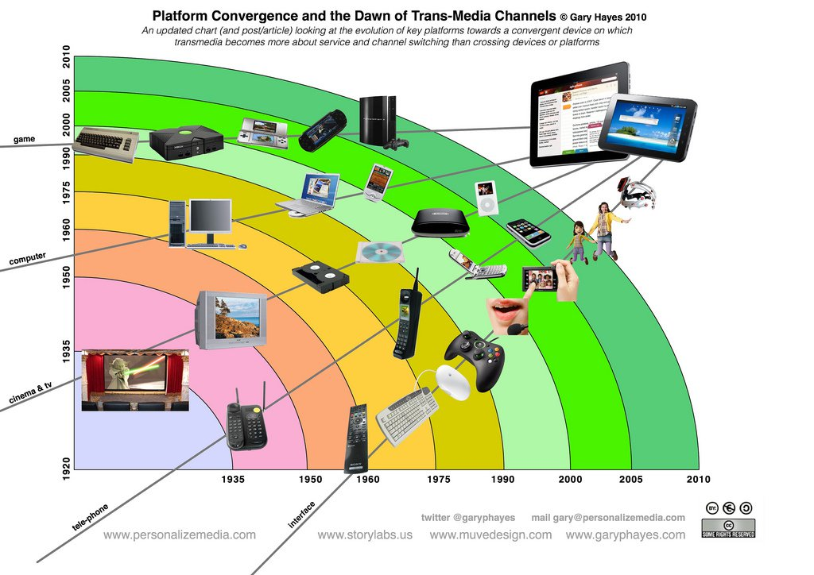
Technological convergence

Slide 10
The production process
Production (this is when the new product gets made)
Distribution (this is where the company advertise and market the film)
Exchange (this is where audience buy, stream, download the product)

Slide 11
Decide where these things would go in the production process
Production
Distribution
Exchange
A trailer is put in the cinema
A film is edited
A poster for a film is created
A decision is made to include the new iphone in the film
An audience member buys the DVD
A social media campaign is launched
A storyboard and script are being created
A teaser is put on social media
A ticket is bought for the film at a cinema
A film is downloaded/streamed
D
P
D
P
E
D
P
D
E
E

Slide 12
Q. What is the point of learning all of these terms? A. You will probably get a question like…
Describe how an institution you have looked at uses horizontal integration effectively.
OR
Discuss the benefits of using synergy to create vertical integration for an institution you have studied.
OR
Explain how cross media ownership can assist in the synergy of product promotion.

Slide 13
Another reminder
Private media conglomerate – companies that own a number of media platforms in all different areas i.e. Disney
Independent company – any media platform that is free of government or company/corporate (conglomerate) funding and agenda
Public service model – funded by the government (originally set up for information purposes)

Slide 14
Private Conglomerates:
Microsoft
JCDecaux
Axel Springer
Grupo Globo (SPAIN)
Discovery Communications
CBS Corporation
Viacom
Bertelsmann
21st Century Fox
Hearst Corporation
Disney
Time Warner
Alphabet
Facebook
Fuji Media Holdings
ITV
CCTV (CHINA)
Comcast

Slide 15
Public Service Models
BBC (UK)
RTHK (Hong Kong)
Prasar Bharati (India)
PBS (US)

Slide 16
Independent Companies
A school newspaper
A public broadcasting network
Dominos (not a media organisation, but I’m always hungry!)
Warp (record label)

Slide 17
Let’s firm up our understanding by carrying out a few activities

Slide 18
In pairs complete the tables and be prepared to feedback your ideas

Slide 19
WHAT ARE THE PROS AND CONS OF THE THREE MEDIA OWNERSHIP MODELS? | PROS | CONS
Independent media companies
media conglomerates | Lots of funding
public service models |  | We have to pay!

Slide 20
RESEARCH ONE TV/FILM INSTITUTION FROM EACH OF THE CATEGORIES BELOW AND FILL IN THE TABLE | Cross media ownership (what types of platforms do they own?) | COMPETITORS | USP (UNIQUE SELLING POINT)
private conglomerate such as ____________________
Independent company such as ____________________
Public funded company such as _____________________

