Slide 1
Cataloguing, organising and storing information

Slide 2
One of the most important skills for a researcher is organising information and making sure it can be accessed quickly

Slide 3
A local film production company has been commissioned by a regional museum to create a video that gives an overview of social realist films in the UK. To begin with, the company needs to research titles of key social realist films and the key personnel involved.
Working in groups you are to visit at least five different sources and research the following information:
Title and year of production
Production companies/distributors
Director and producer
Key acting personnel
Filming locations

Slide 4
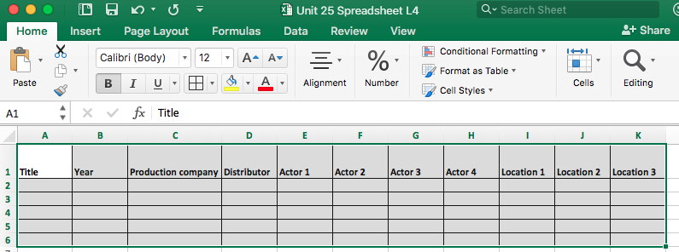
As a researcher your information will need to be shared with others and it needs to be accessed quickly. How might you do this?
Why is a spreadsheet a good way of organising your information?

Slide 5
A local film production company has been commissioned by a regional museum to create a video that gives an overview of social realist films in the UK. To begin with, the company needs to research titles of key social realist films and the key personnel involved.
Working in groups you are to visit at least five different sources and research the following information:
Title and year of production
Production companies/distributors
Director and producer
Key acting personnel
Filming locations
Remember to reference your sources (where you are getting this information from)

Slide 6
Let’s share ideas. How similar/different are your findings? Why is this?

