Slide 1
Unit 25: Researching to create media products
L.O. – How does research inform pre-production and planning of a media product?

Slide 2
How can a ‘gap in the market’ help make a media product successful?
What media products can you think of that have maximised on a gap in the market?
Look at the following article https://www.theidm.com/content-resources/blog/march-2017/how-tv-producers-are-bridging-the-gap-between-soci#. What does this tell us about the media industry and new products created?

Slide 3
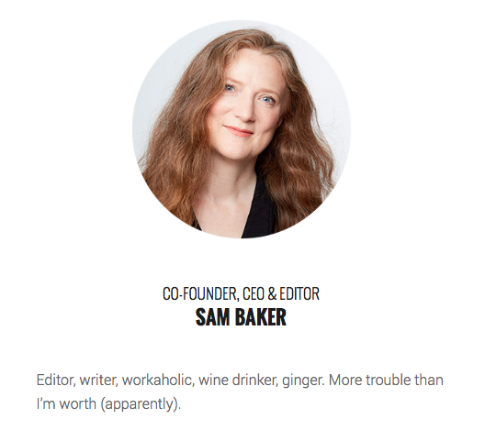
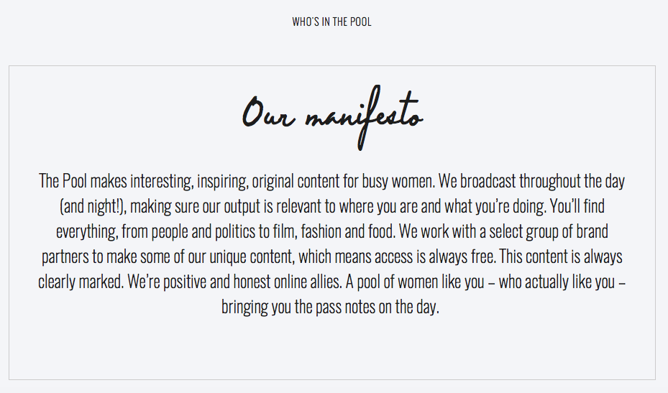
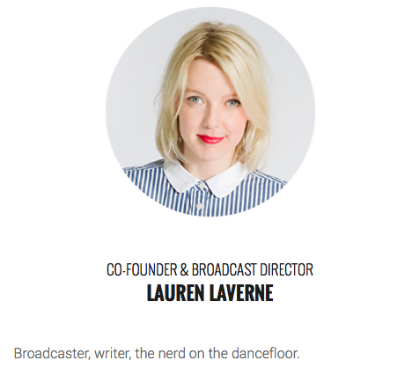
Case Study: The Pool
Sam Baker was the editor of some of Britain’s biggest magazines. She co-founded a free, digital publication (with Lauren Laverne) called The Pool, which is experiencing steady growth.

Slide 4
Success in a rapidly changing media world…
Listen to a section of Radio 4’s The Media Show (Wed 20/9/17).
What does she say about the magazine industry?
How is The Pool using convergent media? How might this make it more successful?
How does The Pool ‘act’ differently from other media texts?
How did they raise money for creating the media product?
Why do you think The Pool is attracting a healthy audience?
How is the advertising different?
Why do you think that the digital publication hasn’t closed even though it hasn’t made a profit?

Slide 5
Carrying out research for media products

Slide 6
Your task:
Look at http://www.barb.co.uk/ and http://www.tvguide.co.uk and identify the most popular types (genres) of television programming across the main UK channels of BBC1, BBC2, ITV, Channel 4, Channel 5 and Sky 1 based on viewing figures. Write down some of the programmes and which channels they belong to under their genre.
Identify the purpose of these programmes and their target audience.
Can you see any gaps in the market in your analysis of the types of programming and audiences that aren’t catered for? Justify your answers with research.
What recommendations would you give to a TV channel executive about bridging the gaps in the market?

Slide 7
Feedback your ideas as if this were a ‘Dragon’s Den’ style presentation to the executives of one of the channels you have investigated. You will be using these findings to help with your next lesson, so keep them safe.

