Slide 1
Unit 25: Research for product development

Slide 2
Magazine show conventions
L.O. – What is a magazine show and what are the conventions?

Slide 3
Your task, as outlined in the pre-release project brief:
Flashbang Productions have been commissioned by a national public service broadcaster to produce a new youth magazine show called ‘Life in Between’. ‘Life in Between’ will have a target audience of 12-17 year olds. The content will provide teenagers with a range of information about health and well-being along with celebrity gossip and film and gaming reviews.

Slide 4
Unit 25 learning objectives
Unit 25 Research for product development
LO1 | Be able to conduct research for a digital media production
LO2 | Be able to use research to inform pre-production and planning
LO3 | Be able to apply research findings to the proposed production processes
LO4 | Be able to use research findings to promote the digital media product
LO5 | Know how feedback is used within research techniques

Slide 5
You need to be aware of the conventions of a magazine TV programme before we do anything else

Slide 6
What is a magazine show?
A show with a number of reports on particular subjects (e.g., current events, entertainment, bungee jumping) interspersed with links by presenters (who appear in the reports).

Slide 7
Examples of magazine shows:
Blue Peter
The One Show
Top Gear
This Morning
Saturday Kitchen
Soccer A.M.
Soccer Saturday
Zoe Ball on Saturday
What’s Up
Countryfile
Sunday Brunch
2Awesome

Slide 8
Your task:
You will be assigned a magazine TV show to watch
You will create a PowerPoint presentation breaking down the conventions of the programme, using detailed research (which means that you state the sources you’re finding the information) and screen shots to support your findings

Slide 9
This should help with questions like:
1 (a) (i) From your research, identify three programmes that provided you with information about the content and technical conventions of youth magazine shows.
(ii) Explain two reasons why one of the above programmes was useful to help you prepare for the development of ‘Life in Between’.
(b) Identify two sources of secondary information that you could use to find out information about the popularity of youth magazine shows.
(c) Pick one technical convention of youth magazine shows and justify why you would need to plan to use it when producing ‘Life in Between’.

Slide 10
The mark scheme

Slide 11
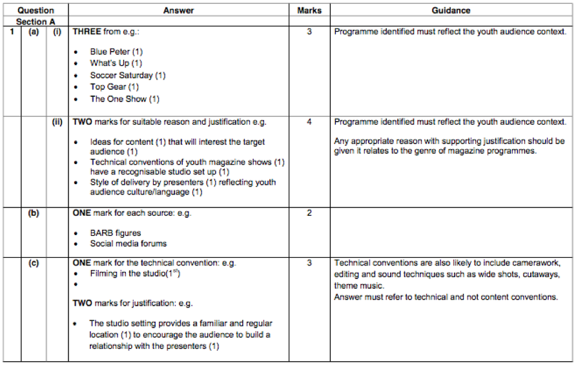

Slide 12
Codes and conventions
How does the programme communicate messages to its audience (codes) and what are the things we expect to see (conventions)

Slide 13
Things to consider and how it links to the target audience. Why have choices been made? (connotations)
Technical codes: mise-en-scene, camerawork, editing, lighting etc. and symbolic
Presenters / co-presenters (why are they a good choice? On screen relationship?)
Show format
Scheduling (what ways can you watch it other than when it originally airs?)
Content
Mode of address and presentation style (How are audiences engaged?)
How the show is marketed/advertised?
What is their presence on social media? How is it used within the programme?
Set design / Studio presentation and colour scheme
Opening titles
Budget (http://downloads.bbc.co.uk/commissioning/site/tariff_prices_for_independents.pdf and https://www.nao.org.uk/wp-content/uploads/2017/10/Short-Guide-to-the-BBC-1.pdf)
Purpose
Key job roles (see credits to help)
Target audience / audience breakdown (if it can be found: BARB etc.)/ measures of success (critically acclaimed? How established is the programme?
How do they attract the target audience? How is it different to what is already scheduled (unique selling point)?
Anything else of interest?

Slide 14
How will these findings help you to do well in the examination?

