Slide 1
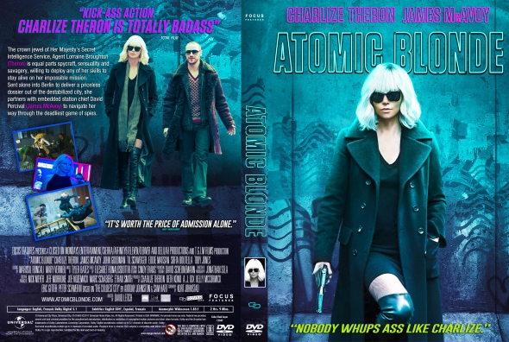
Homework: Exam question
Compare how women are represented in the Tide advert you have studied and the Atomic Blonde DVD cover. [30]
In your answer you must:
consider how the representations construct versions of reality
consider the similarities and differences of the representations presented to an audience
make judgements and draw conclusions about how far the representations relate to relevant media contexts
You must time yourself carefully. Give yourself 15 minutes to plan how you will answer this question and then a full hour to answer the task.
You must include (reread your class notes as you plan):
Theories: semiotics, structuralism, enigma codes, feminism (bell hooks and Van Zoonen)
Social and political context
Media terminology

Slide 2
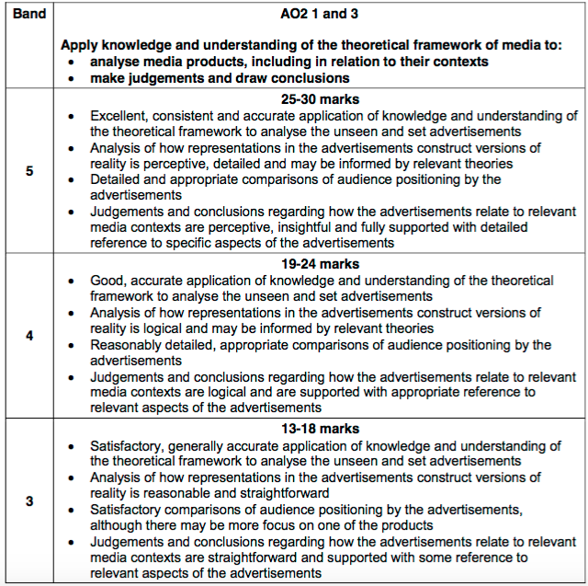
Mark scheme

Slide 3
